Slide 1


Recording, Analyzing and Using Physiological Signals in Psychology
Dominique Makowski
D.Makowski@sussex.ac.uk
04/2024 Workshop at

Slide 2
Cardiac Activity (ECG & PPG)

Slide 3
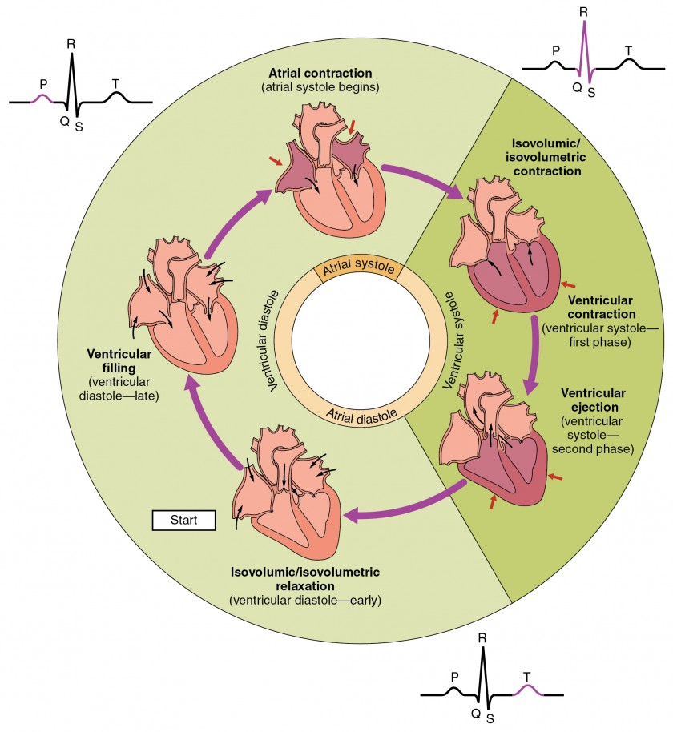
Cardiac Anatomy
2 Parts
Atria: upper chambers (receives blood from the veins)
Ventricles: lower chambers (sends blood to body through arteries)
2 Phases
Systole = Muscle contraction (ejects blood)
Diastole = Muscle relaxation (fill with blood)
Cardiac Cycle
Atria pumps blood to ventricles (atrial systole)
Ventricles pumps blood to body (ventricular systole)
Relaxation and filling up of atria (diastole)

Slide 4
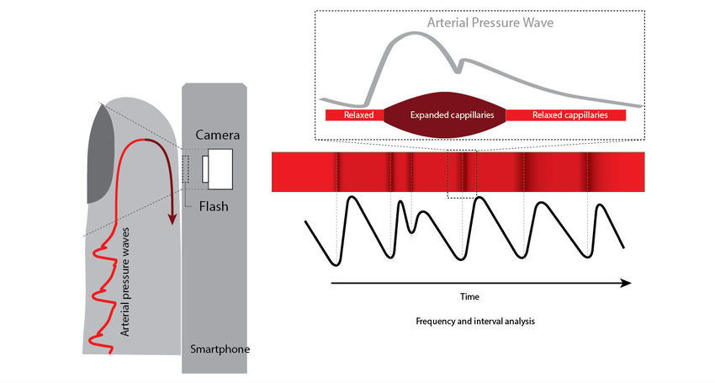
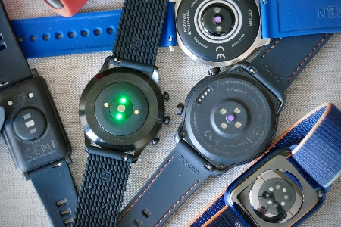
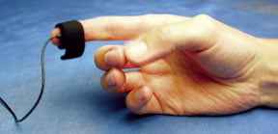
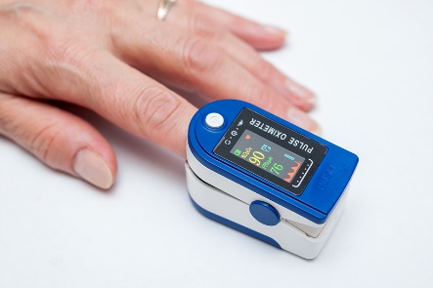

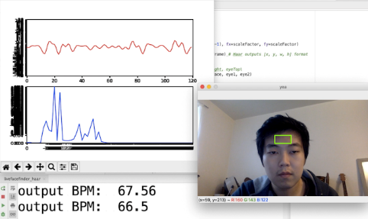
Photoplethysmogram (PPG)
Photoplethysmogram (PPG)
“photo” means “light” and “plethysmos” means “to increase”
≈ Blood Volume Pulse (BVP)
Equipment
PPG can be obtained from transmissive absorption (fingertip, earlobes) or reflection (forehead)
Pulse Oximetry: illuminates the skin and measures changes in light absorption related to blood oxygen saturation
rPPG: remote PPG via webcam by measuring the natural skin colour microvariability
Easiest way to record cardiac activity data
Easily available (wearables)
Measures peripheral blood flow (Pulse)
Indirect measure of cardiac activity

Slide 5
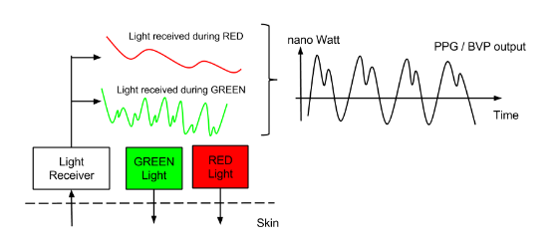

PPG signal(s)
Traditionally, only the infrared (IR) signal (approximately 940 nm) is used for PPG: more stable over time compared to the red signal (660 nm), which is more susceptible to changes in the oxygen saturation
Green + Red light is also sometimes used instead of IR
Unit: unitless (relative changes) because no standardization procedure
Recommended minimum sampling frequency: > 200 Hz (200 datapoints per second)
PPG is the name of the raw signal and BVP usually corresponds to filtered signal (removing slow drifts to isolate the cardiac pulse)
Increases in BVP amplitude indicate vasodilation of the capillary bed → parasympathetic response
Decreases in BVP amplitude indicate vasoconstriction of the capillary bed → sympathetic response

Slide 6
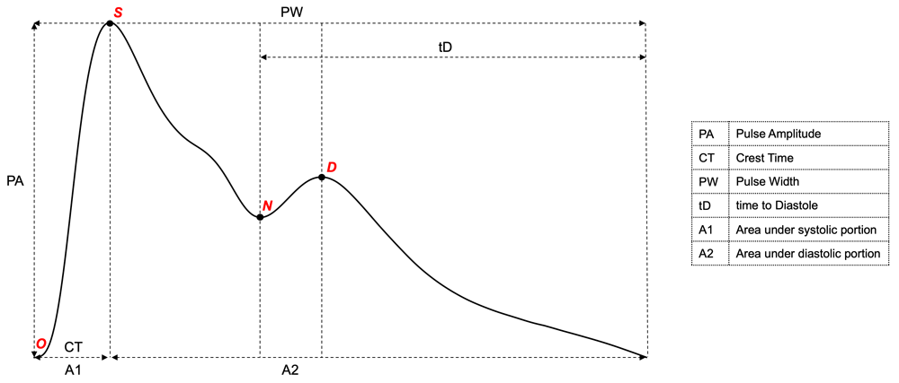
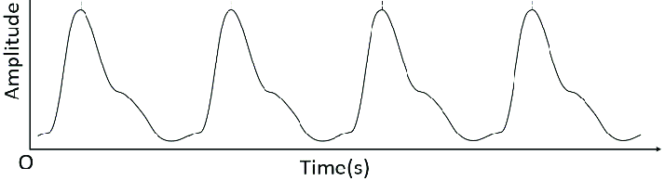
Pulse Waveform Morphology
Pulse waveform is related to the central aortic pressure wave, and is the combination of:
A systolic wave caused by the increase in pressure, and therefore volume, arising from left ventricular contraction and ejection of oxygenated blood into the arterial system
A second reflectance wave, often referred to as the ‘diastolic’ wave
The “perfect” pulse wave has 2 peaks
In practice, often one.
OSND = the predominant fiducial points:
O - Origin
S - Systolic peak
N - Dicrotic notch
D - Diastolic peak
Morphology of the waveform could carry psychophysiological meaning
Adrenaline (i.e., epinephrine) infusion resulted in generalised vasodilation and a lowered diastolic portion relative to the systolic wave
Noradrenaline (i.e., norepinephrine) infusion, which conversely increases peripheral resistance, resulted in a relatively heightened diastolic portion
Waveform characteristics could be potentially related to physiological arousal & interoception (more studies are needed)
Williamson et al. (2022). The Hybrid Excess and Decay (HED) model: an automated approach to characterising changes in the photoplethysmography pulse waveform.

Slide 7
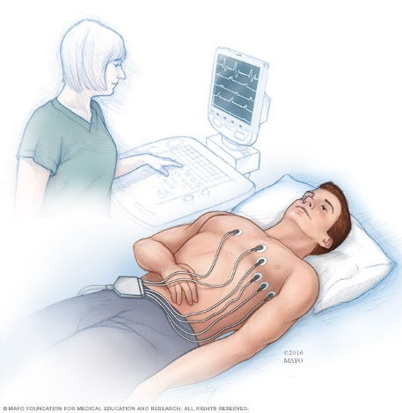
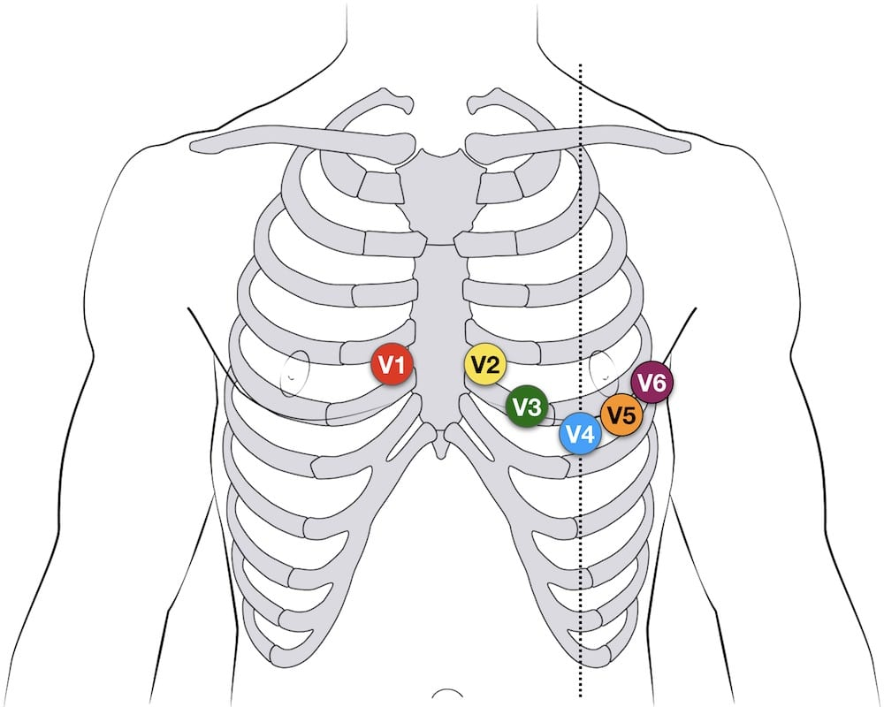
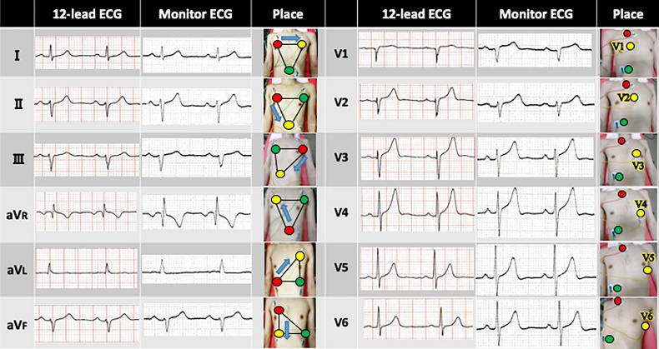
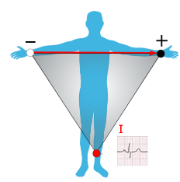
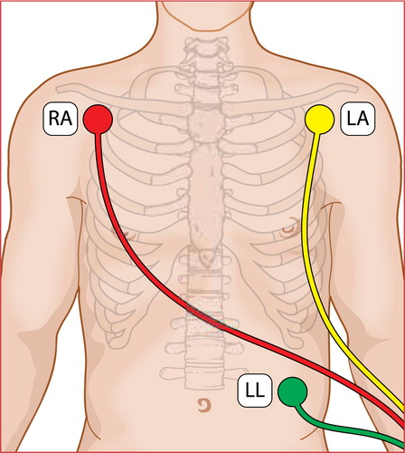
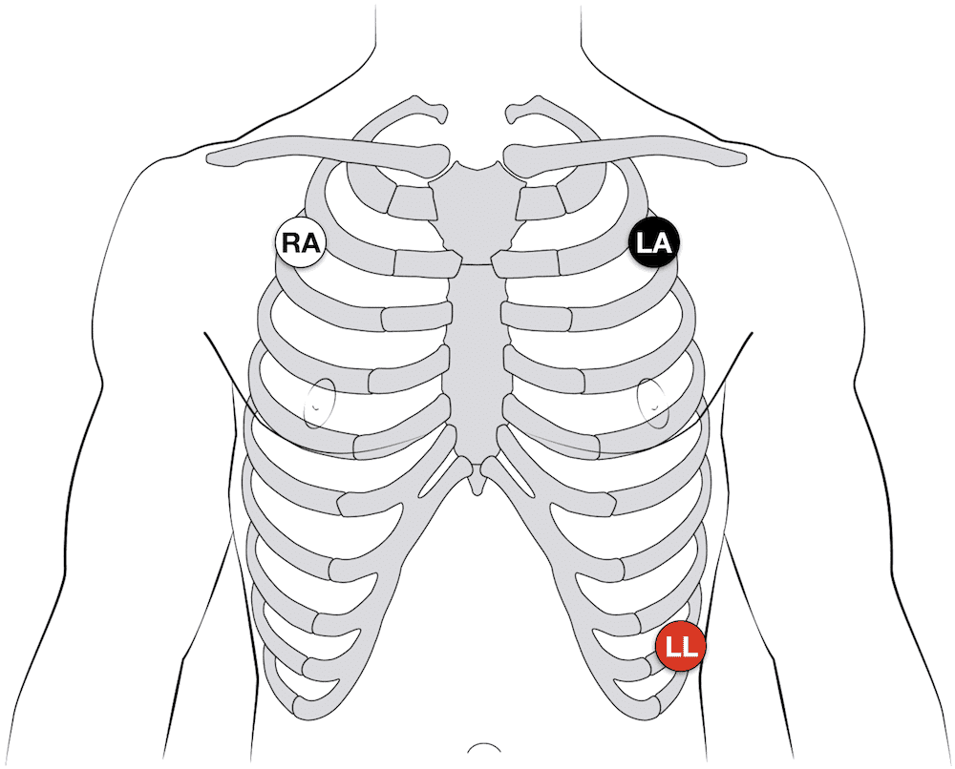
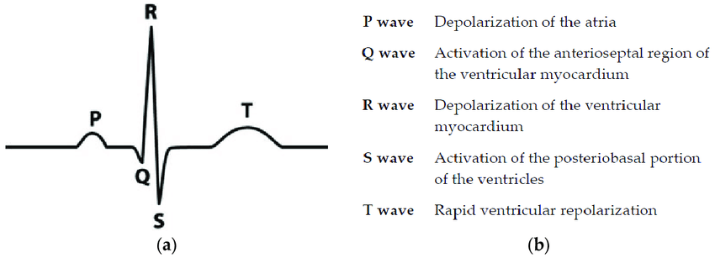
Electrocardiogram (ECG)
Electrocardiogram (ECG)
= EKG (elektrokardiogramm in German)
Equipment
Multilead (12-lead)
6 electrodes
Used in cardiology
Magnify different features of the cardiac complex
Single lead
Used in psychophysiological research
3 electrodes (+, -, and REF)
Often white (-, RA), black (+, LA), red (REF, LL)
Different possible configurations (lead I most popular)
Possibility of distal placement (arms and leg) at the cost of signal quality
Cardiac Complex = QRS Complex
R-peak: most important feature
P, Q, S, T waves
Lead I
- +

Slide 8
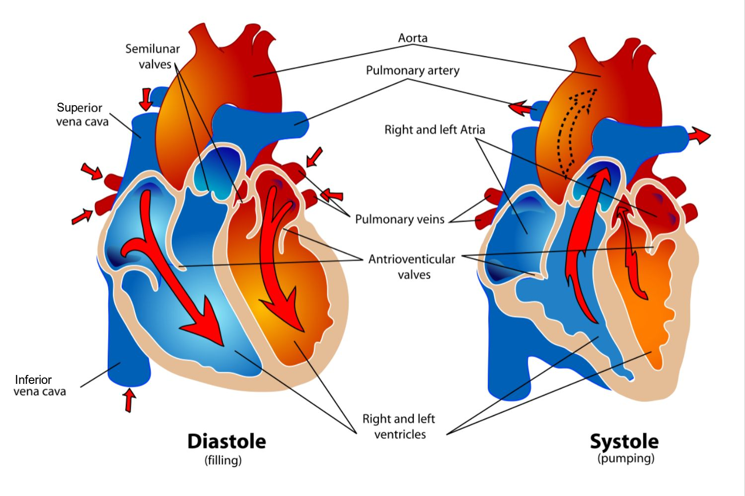
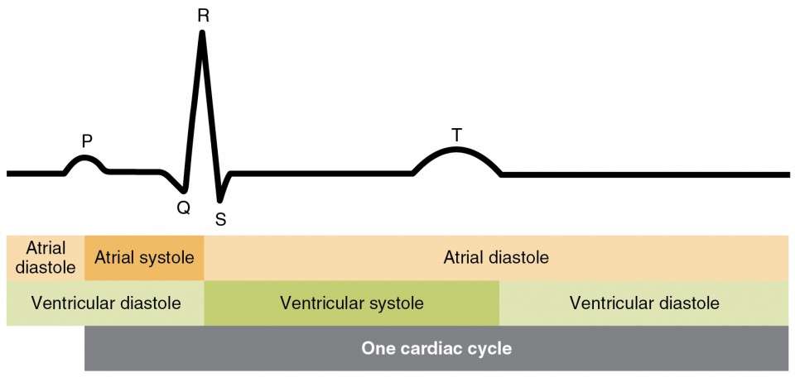
Cardiac Phase
Cardiac Phase (most studies focus on ventricular phase)
Systole (ventricular)
Blood is ejected through the arteries
Arteries expansion activates the baroreceptors (pressure sensors)
Cardiac state (strength and timing) is relayed to the brain
Diastole
During diastole baroreceptor are quiescent
ECG Signal Delineation
Identifying the location (+ beginning / end) of QRS waves
Important for precise cardiac phase indentification
Systole = from R-peak to end of T-wave
Hard to do algorithmically (+ requires good signal)
Heuristics have been used (e.g., systole 0-300 ms post R-peak)
But do not take into account inter & intra-individual variability

Slide 9
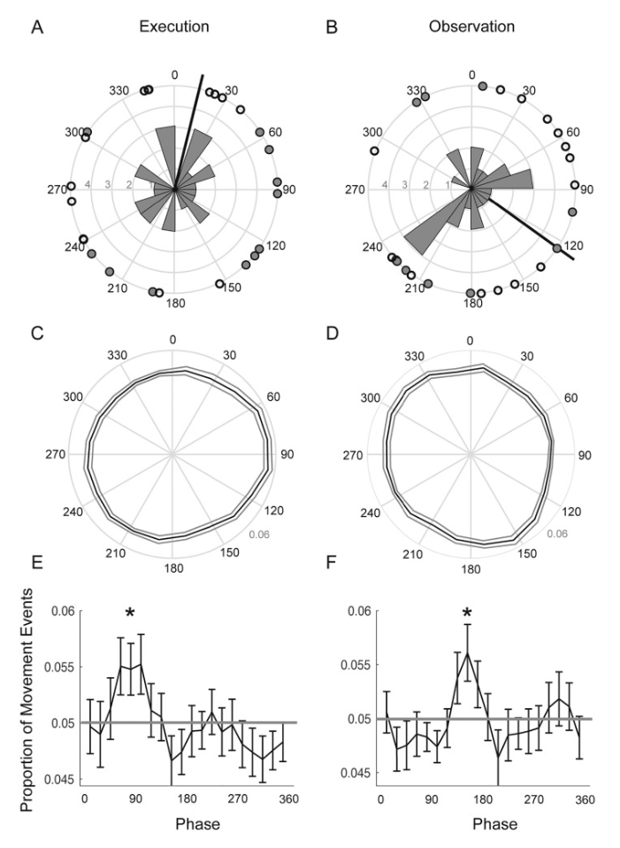
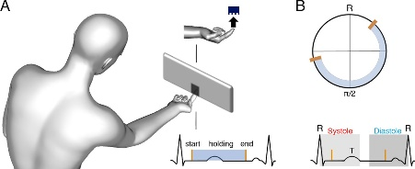
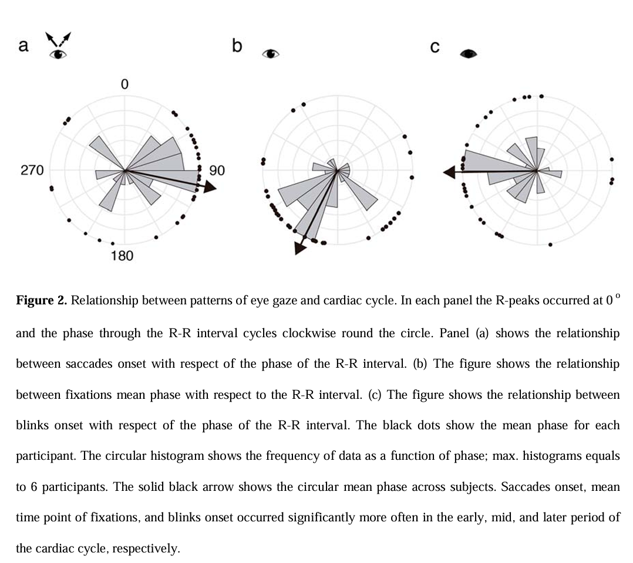
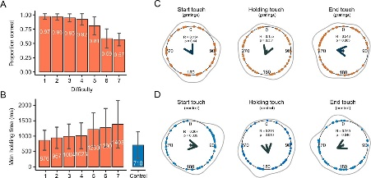
Cardiac Phase influences Behavior
Evidence suggesting that behavior is coupled with the cardiac phase
Motor action (Palser, E. R., Glass, J., Fotopoulou, A., & Kilner, J. M. (2021). Relationship between cardiac cycle and the timing of actions during action execution and observation. Cognition, 217, 104907)
Information gathering (Galvez-Pol, A., Virdee, P., Villacampa, J., & Kilner, J. (2022). Active tactile discrimination is coupled with and modulated by the cardiac cycle. Elife, 11, e78126)
Visual search (Galvez-Pol, A., McConnell, R., & Kilner, J. M. (2020). Active sampling in visual search is coupled to the cardiac cycle. Cognition, 196, 104149)

Slide 10
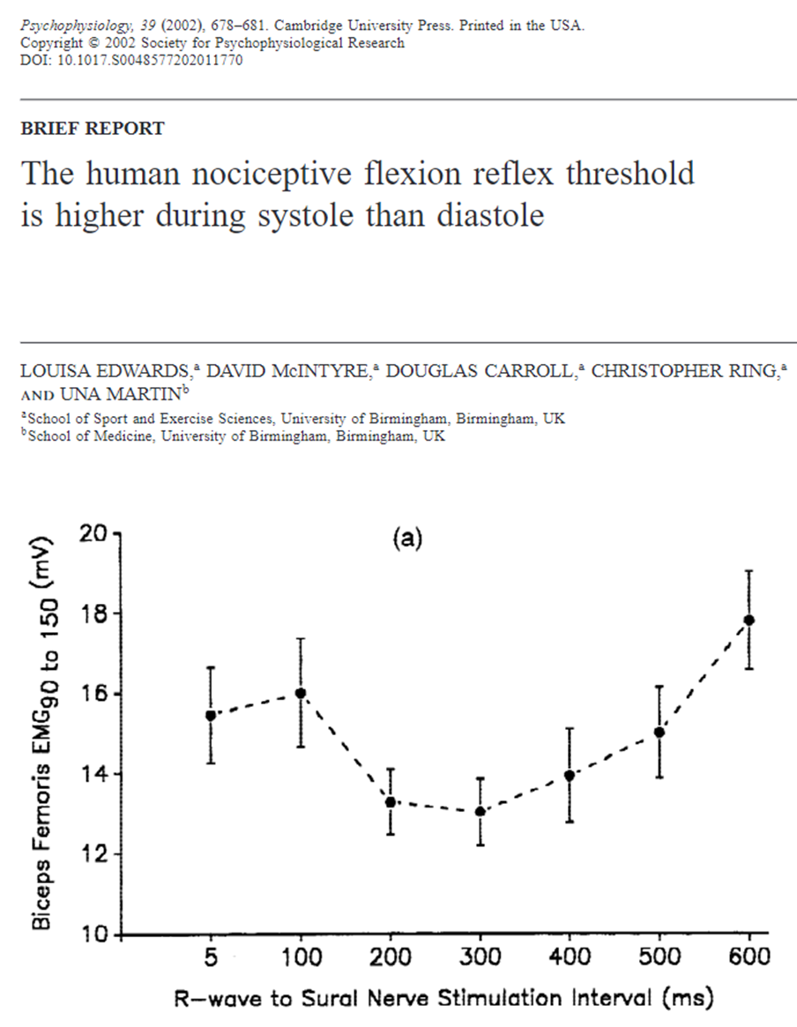
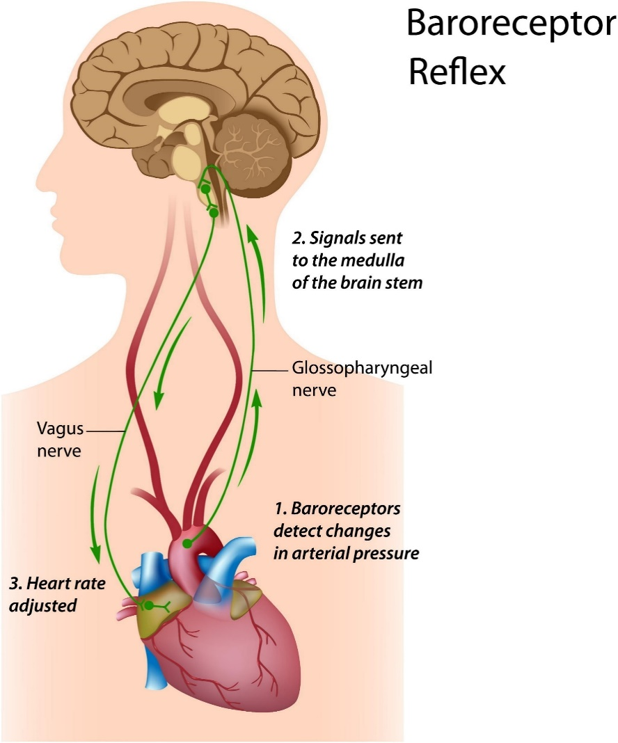
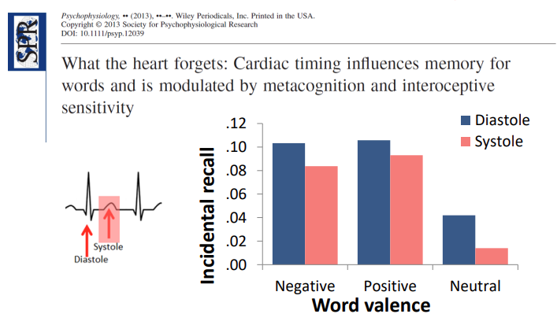
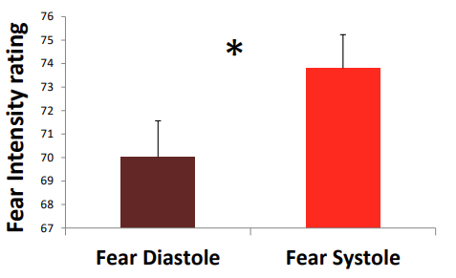
Cardiac Phase: Effect on Cognition
Mechanism
During the cardiac ejection period (systole), arterial baroreceptors signal cardiovascular arousal to brain stem (medulla), which is then relayed to other regions, such as the anterior cingulate cortex (ACC), amygdala and insula (but anatomo-functional link between cardiac phase and brain activity still poorly understood)
Effects
“Inhibitory effect” of systole (Lacey and Lacey, 1978)
Nociception attenuated during systole (Edwards, 2001, 2002)
Memory encoding worse during systole (Garfinkel, 2013)
Time perception contracts during systole (Arslanova, 2023)
Emotions (Garfinkel, 2014)
Cognitive control (Makowski, 2020)
Awareness (Park, 2014)
🔥 Hot topic of research

Slide 11
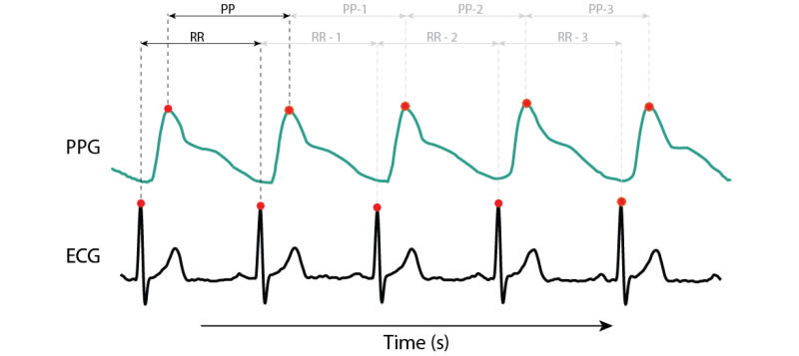
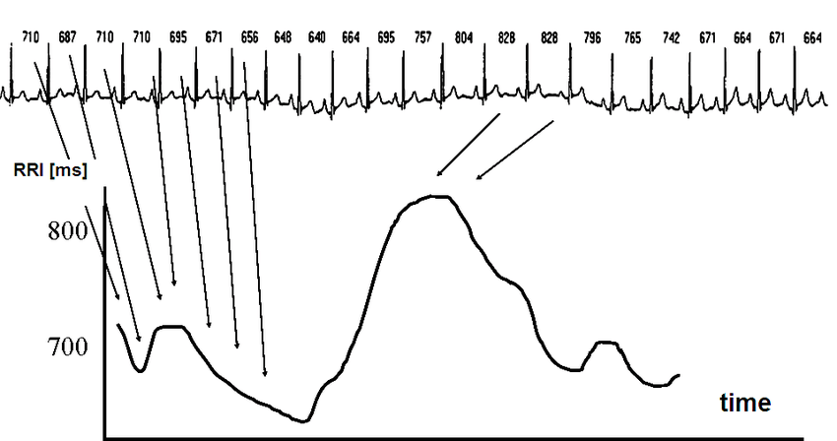
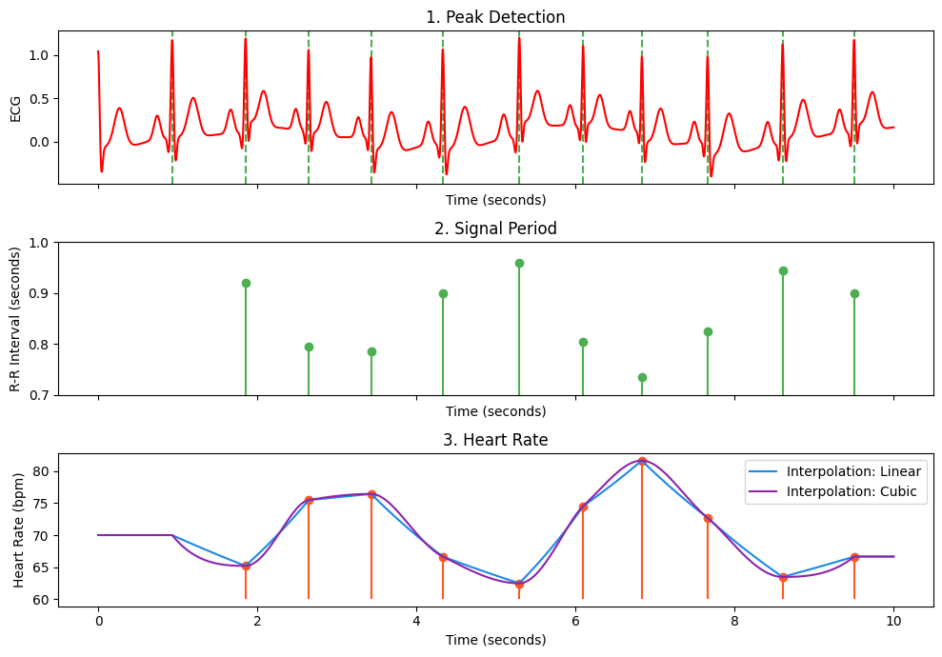
Heart Rate
Peaks identification is a critical processing step
Various algorithms exist with strengths & limitations
Heart Rate Computation
Peaks indices
Compute “period”: Consecutive Differences R+1 – R in seconds
These are “R-R intervals” (RRi)
= Inter-beat Intervals (IBI)
≈ Normal to Normal Interval (NN)
RRi corresponds the “reverse” of heart rate (HR)
= Larger values = longer interval = lower rate
Heart Rate (HR) = Number of beats per minute (in BPM)
Interpolation: often the values of HR (which are discrete) are interpolated (what method? Often: assumption of a continuous process)
Rate computation is also used with other signals that have discrete events (e.g., peaks) such as PPG, Respiration, Blink rate, ...
Heart Rate is complex

Slide 12
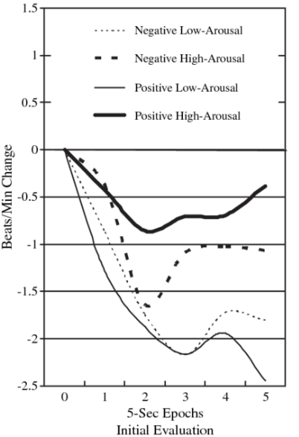
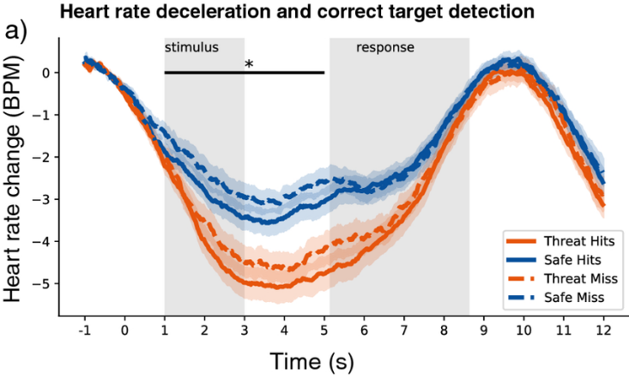
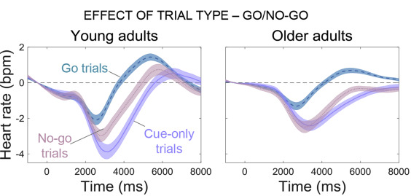
Heart Rate Deceleration
Momentarily deceleration (= briefly increase of RRi) of HR often following an “event” (e.g., stimulus presentation)
Short range change (0 – 5 s)
An event-related form of Heart Rate Variability (HRV)
Observed in
Affective processing
Attentional orientation & engagement
Awareness
Different possible indices
Amplitude of deceleration (e.g., min([0-5 s]) - baseline)
Speed of deceleration (e.g., time-to-min)

Slide 13
Cardiac Indices
Predictive Indices
Cardiac phase (systole vs. diastole)
Heart rate at stimulus onset (index of arousal)
…
State-related Indices
Average of heart rate in a given task / condition
Heart Rate Variability (HRV)
…
Event-related Indices
Heart Rate deceleration (amplitude, speed, …)
…
Cardiac activity is a highly reactive measure conveying information about physiological states, and their interaction and integration with neurocognition.
It is a very rich signal (= many indices can be extracted) with important applications in psychophysiology and interoception, that continues to be a promising area of research

Slide 14
Quizz
True / False?
BVP corresponds to « Business Value Proposition » and has nothing to do with physiology
PPG is a cost-effective way to record cardiac activity-related data
PPG can only be estimated by sending infrared light through the finger
OSND stands for « Obviously Sussex No Danger»
QRS stands for « Quality Resting State »
Systole corresponds to the blood éjection phase
ECG signal delineation corresponds to the process of identification of the various waves
Ventricular Diastole is from the end of the T-wave to the next R-peak

Slide 15
Heart Rate Variability (HRV)

Slide 16
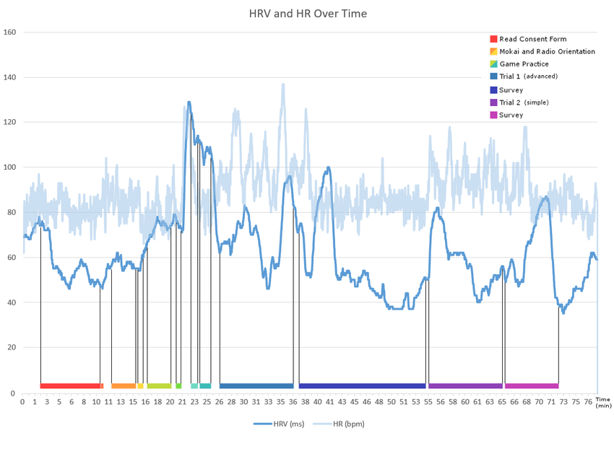
Heart Rate Variability (HRV)
A complex and constantly changing heart rate is an indicator of healthy regulatory systems that can effectively adapt to sudden environmental and psychological challenges
Higher HRV = more adaptive nervous system
Higher HRV associated with positive outcomes (physical & mental health)
Reduced HRV associated with poor cardiovascular health outcomes, vascular diseases, mental disorders and cognitive impairments
Many systems influence HR at the same time, which operate on different time scales. HRV is itself distributed across different frequency bands, with a mix of high and low frequency changes corresponding to different neurophysiological mechanisms

Slide 17
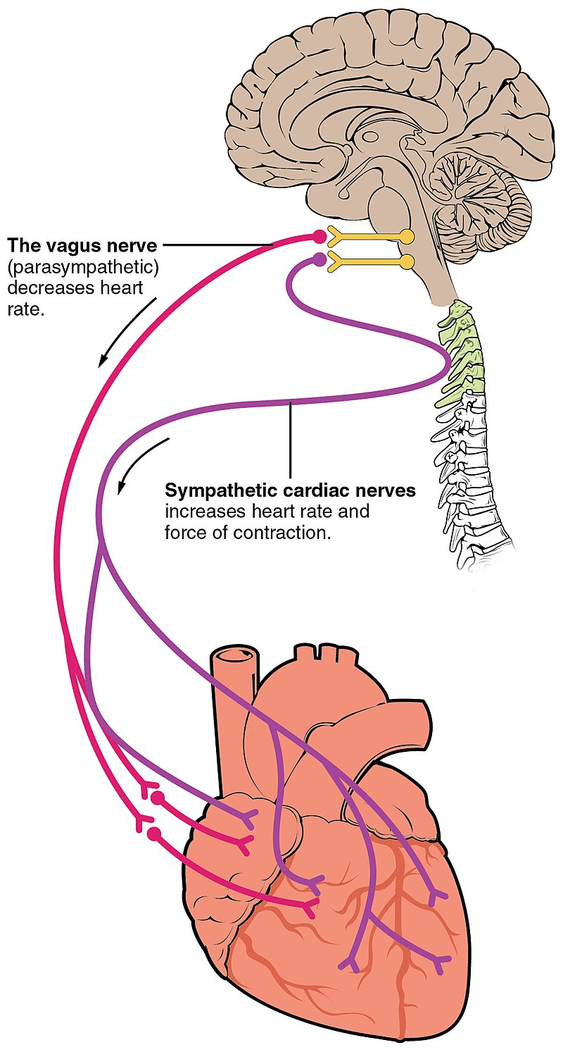
High vs. Low Frequency Variability
HRV contains a mix of variability at different time scales
Rapid HR changes reflect the cardiac regulatory influences of the autonomic nervous system (ANS), in tandem with its dynamic interaction with cardiovascular and respiratory activities (Respiratory Sinus Arrythmia - RSA).
Measures the “baroreflex”, one of the body's homeostatic mechanisms that constantly adjust HR to maintain a steady blood pressure. The stronger the baroreflex, the more frequently the HR is adjusted to maintain a stable level of blood pressure. Greater high-frequency HRV = stronger baroreflex.
Slow HR changes reflect bodily fluctuations of lower frequency, such as circadian rhythms, sleep cycles, metabolism, and changes in body temperature and hormonal systems
In practice, the length of recordings naturally limits the sources of variability that can be quantified.

Slide 18
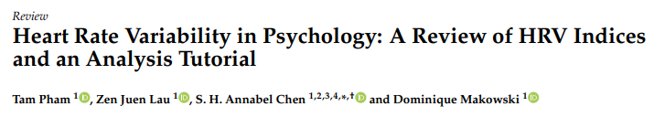
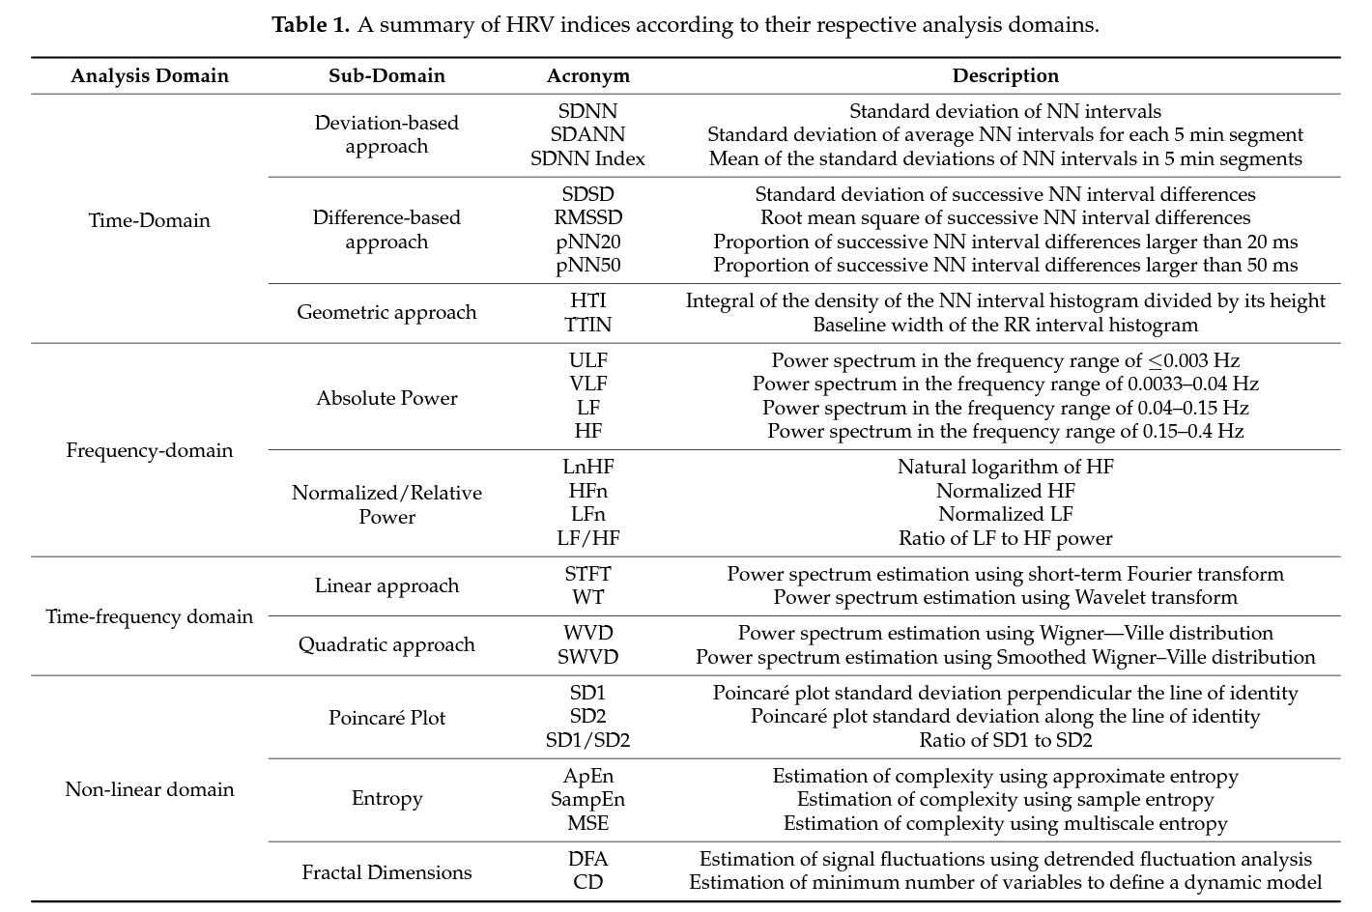
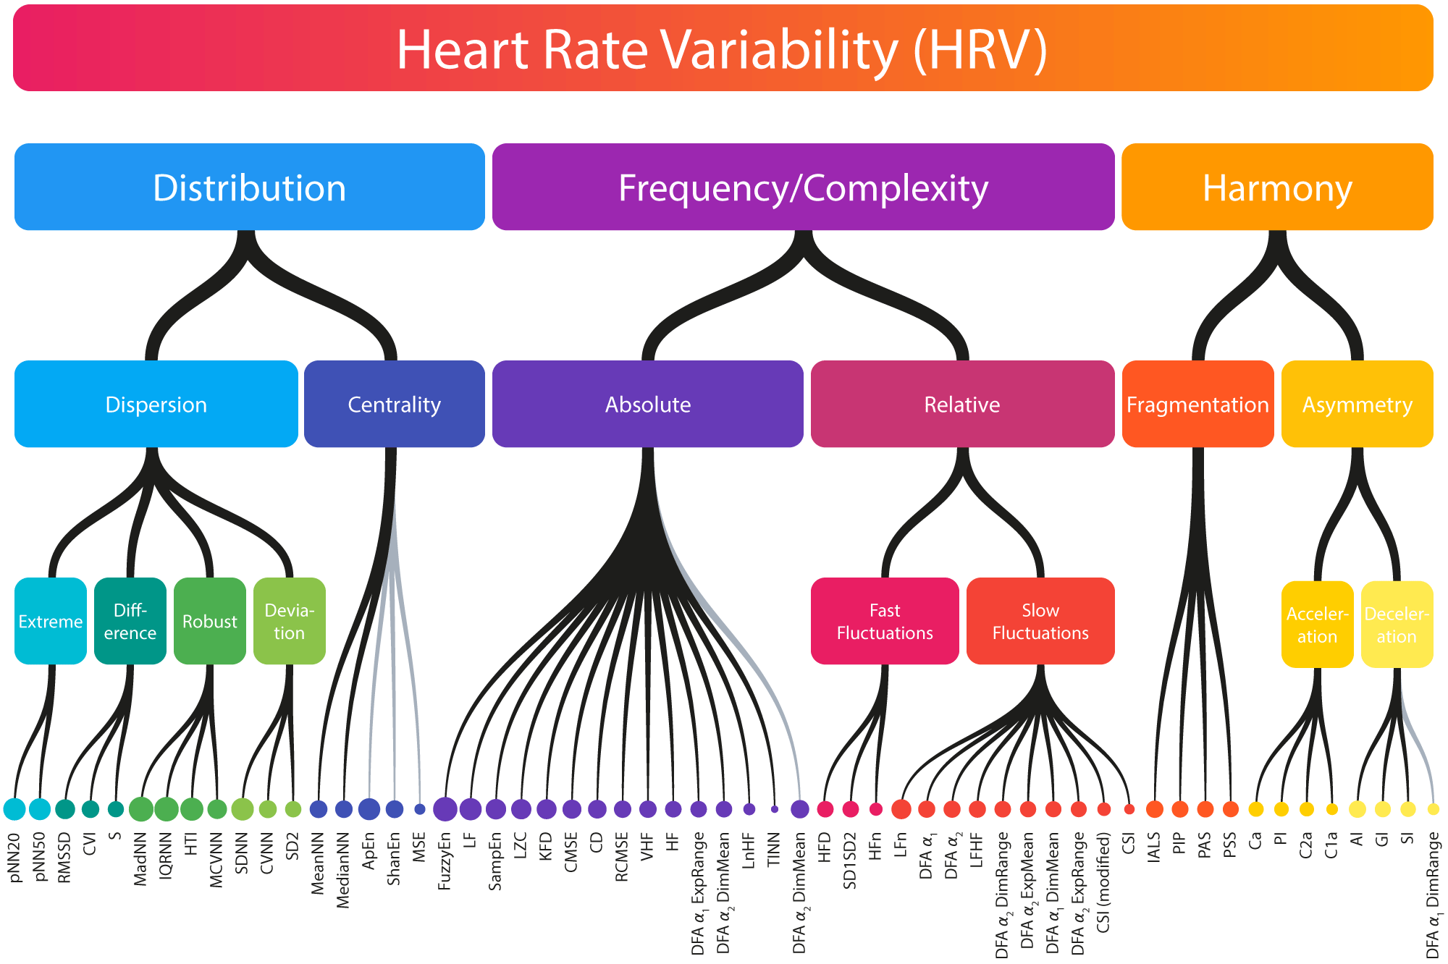
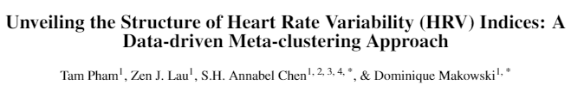
HRV indices
HRV is a popular physiological “index”
But it is not a single “index”
More than 100 existing indices…
🔥 Their structure and organization is an active area of research
Mathematical Classification (practical approach)
Time-domain: SDNN, RMSSD, …
Frequency-domain: High/Low-frequency power, …
Non-linear (= “complexity”) domain: Entropy, fractal dimension, …
Problem: uninformative regarding functional role or statistical relationship (e.g., different indices from different domains are equivalent: RMSSD = SD1)
Functional Classification (theoretical approach)
Short-term variability
Long-term variability
Problem: some indices might capture multiple “sources”. Requires a somewhat artificial distinction
Statistical Classification (empirical approach)
Group items that correlate to each others
Work in progress (e.g., Pham et al., preprint)

Slide 19
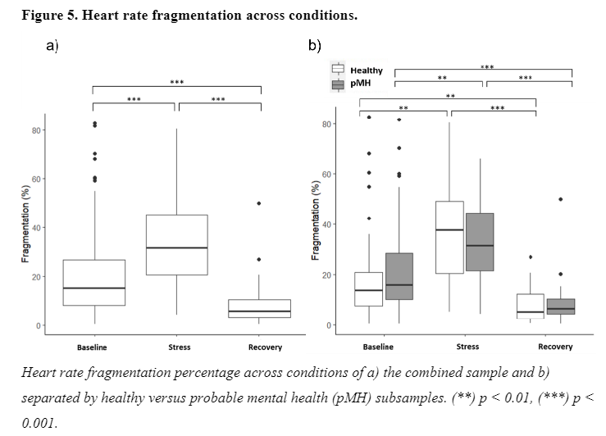
Heart Rate Fragmentation
https://www.researchgate.net/publication/375783851_Heart_rate_fragmentation_A_novel_analytic_approach_to_early_allostatic_load_detection_among_healthy_adults

Slide 20
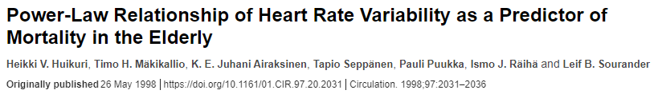
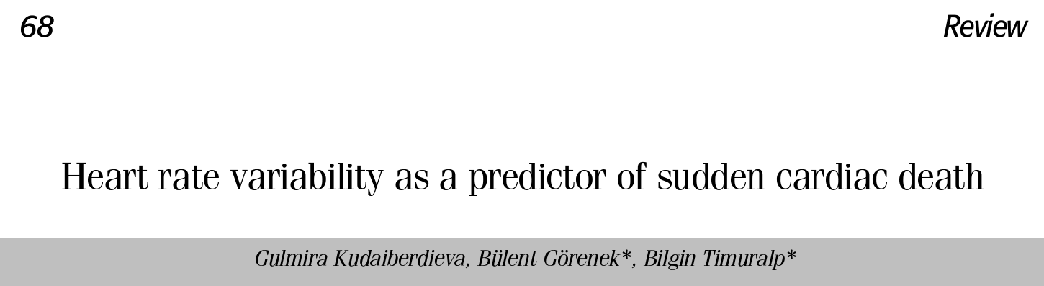

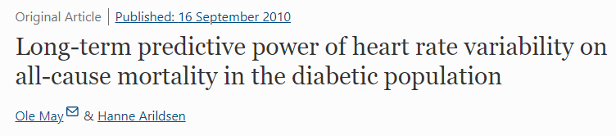
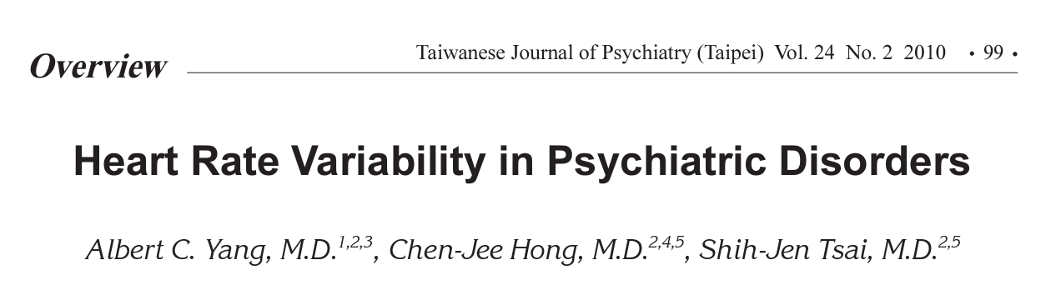
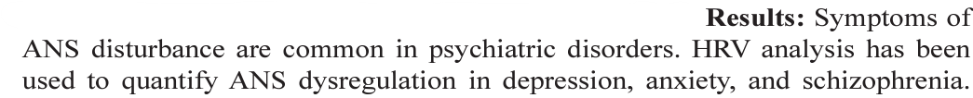
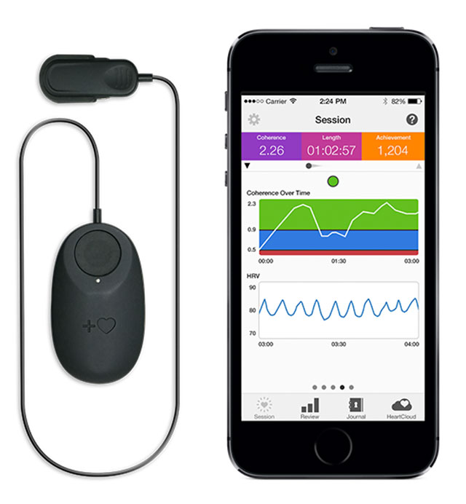
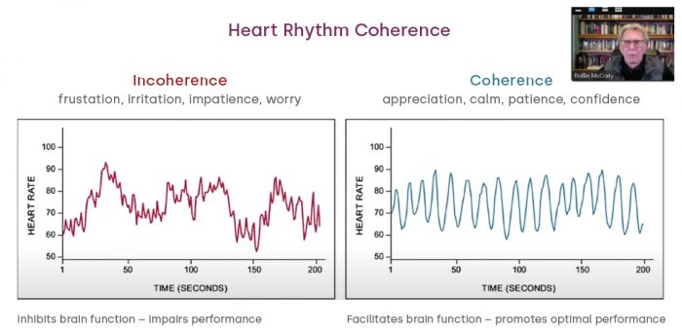
Application - Health
Medicine
Predictor of health & disease
Associated with mental health
Biofeedback
Used in therapy (e.g., CBT) to teach that we can consciously (e.g., through breathing) modulate our physiological state (e.g., racing heart in anxiety)
HRV used as a target index for various wellbeing programs (e.g., meditation, “Cardiac Coherence”, breathwork, …) – More or less scientifically grounded

Slide 21
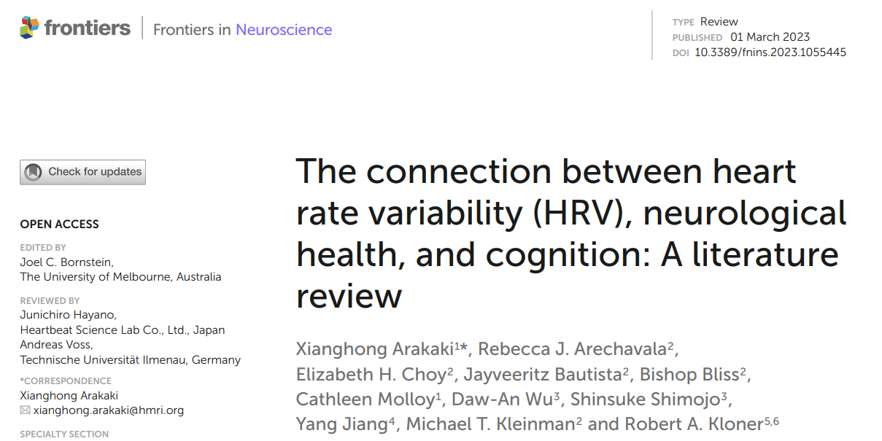
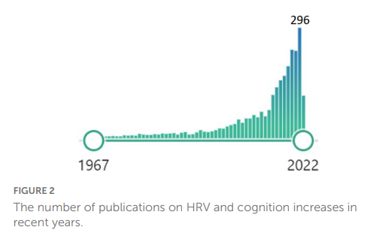
Application - Neuropsychology
Correlation between HRV and cognitive abilities
HRV is correlated with better executive functions (Williams et al., 2019)
Working memory
Inhibition
Flexibility
Attention
…
HRV is correlated with better emotion regulation skills (Sakaki et al., 2016)
HRV was associated with stronger connectivity between amygdala-medial prefrontal cortex (mPFC)
Predictor of neurological disorders
Early marker of cognitive impairment and Dementia (Forte et al., 2019)
Sensitive to Mild traumatic brain injury (mTBI) and concussion (during the acute phase)
HRV lower in migraine
HRV predictive of stroke
Epilepsy: HRV increases before seizure onset
…
Psychopathology
Anxiety, Schizophrenia, … (Arakiki et al., 2023)

Slide 22
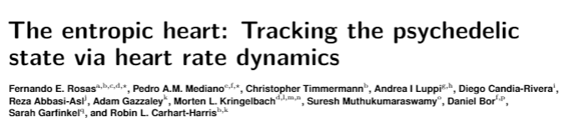
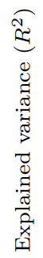



Application – Consciousness science
Is HRV a potential biomarker of the phenomenology of our conscious experience?
Rosas et al., (2023)
HRV related to phenomenological features / sense of reality during psychedelic experiences (e.g., with LSD and DMT)
🔥 Hot topic of research

Slide 23
Quizz
True / False?
HRV measures the balance between SNS and PNS
HRV is hard to record, but easy to interpret
High-frequency HRV relates to circadian rythms
Having a chaotic heart rate is dangerous because chaos is bad
If we had a completely steady heart rate we would die

Slide 24
Electromyography (EMG)

Slide 25
Electrogastroencephalography (EGG)

Slide 26

Thank you
Dominique Makowski
D.Makowski@sussex.ac.uk

